Slide 1

FIT PRO – DIET PLAN WEBSITE

Slide 2
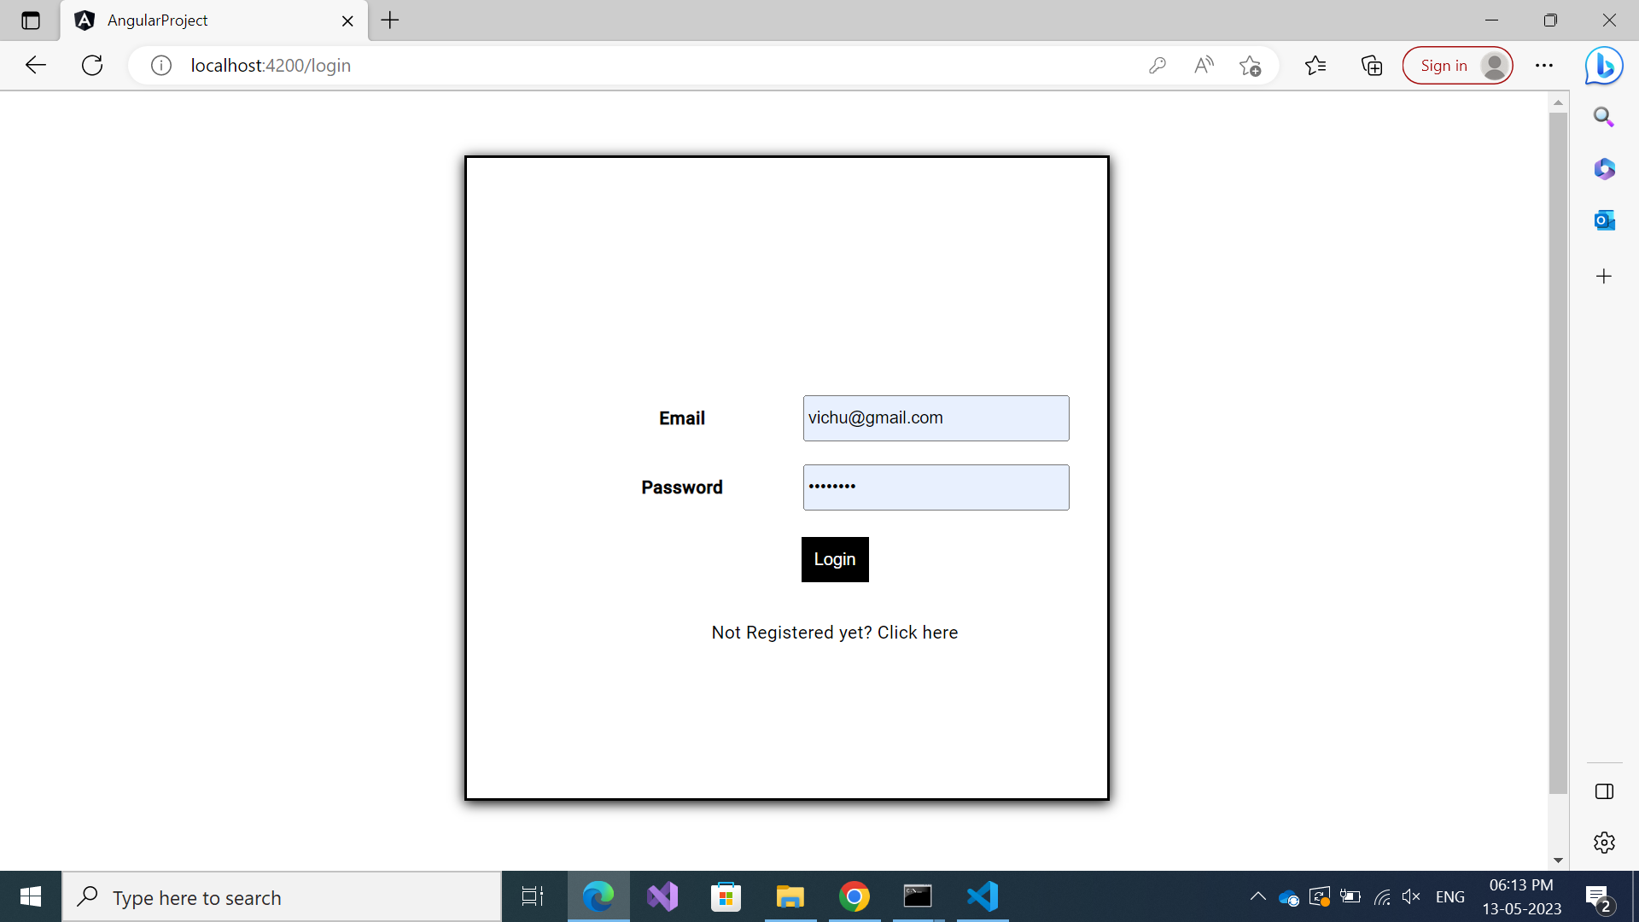
LOGIN PAGE
The user can login using
their credentials , if they
are new user they can
Sign up and register.

Slide 3
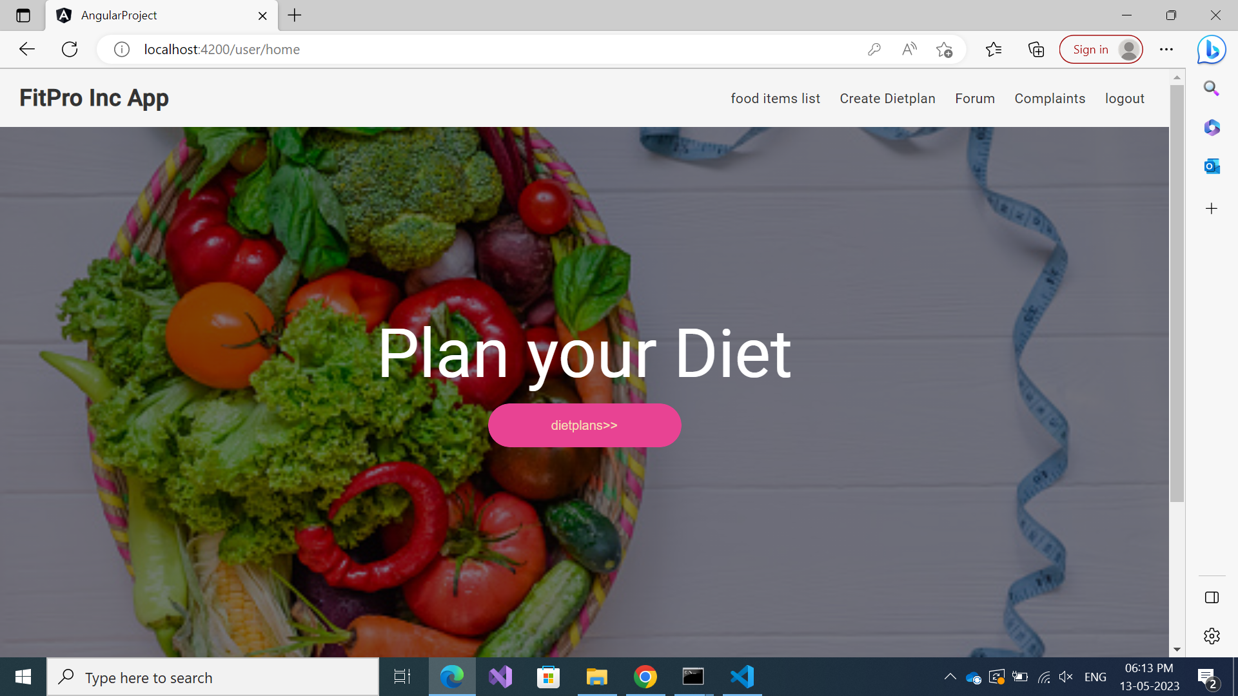
HOME PAGE

Slide 4
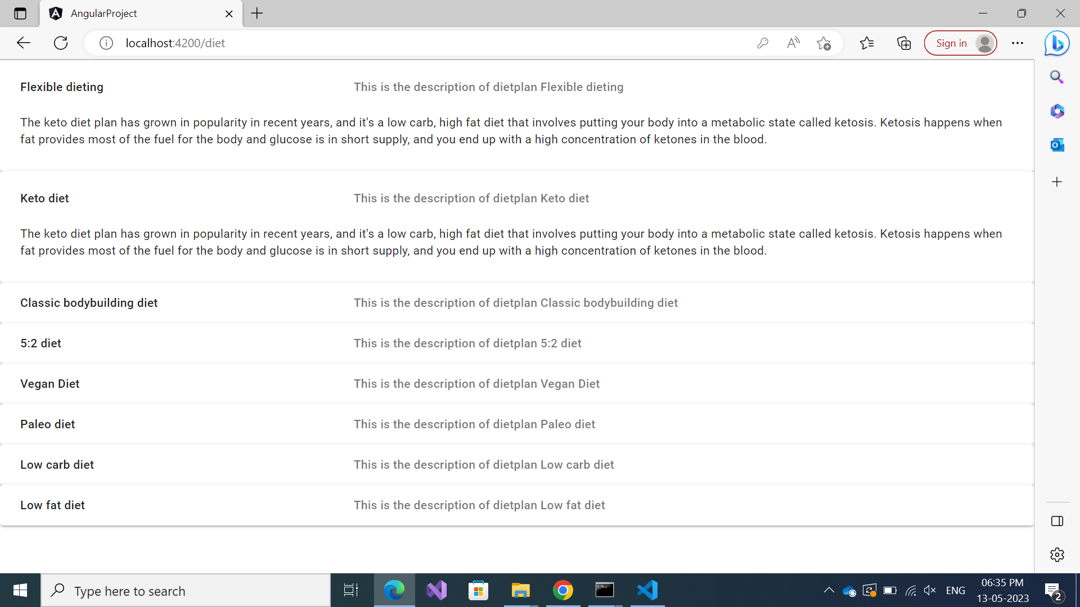
DIET PLANS PAGE
The default diet plans are
Displayed and the
Description and Benefits
and uses are also
Displayed.

Slide 5
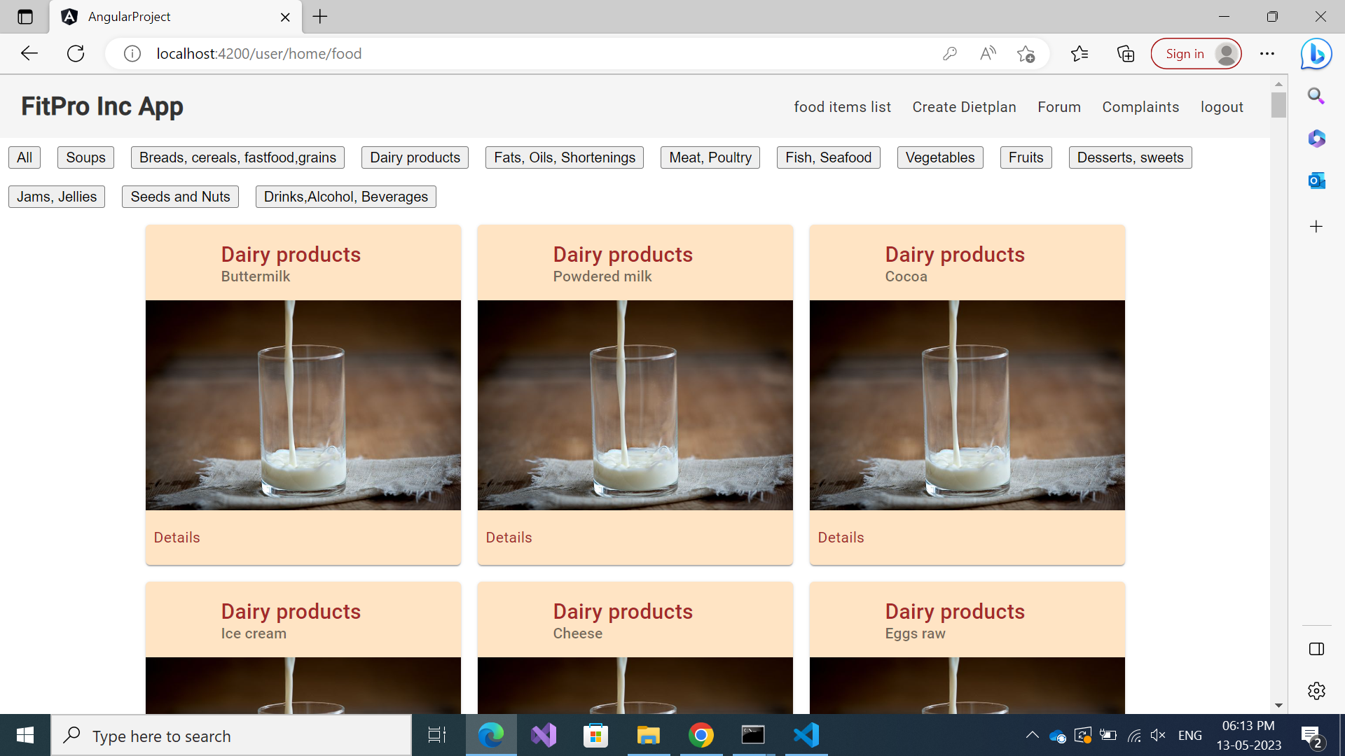
FOOD ITEMS LIST
The food products are
Displayed based on their
Categories and the food
Image is clicked
Nutritional values of that
Particular product will
Be displayed

Slide 6
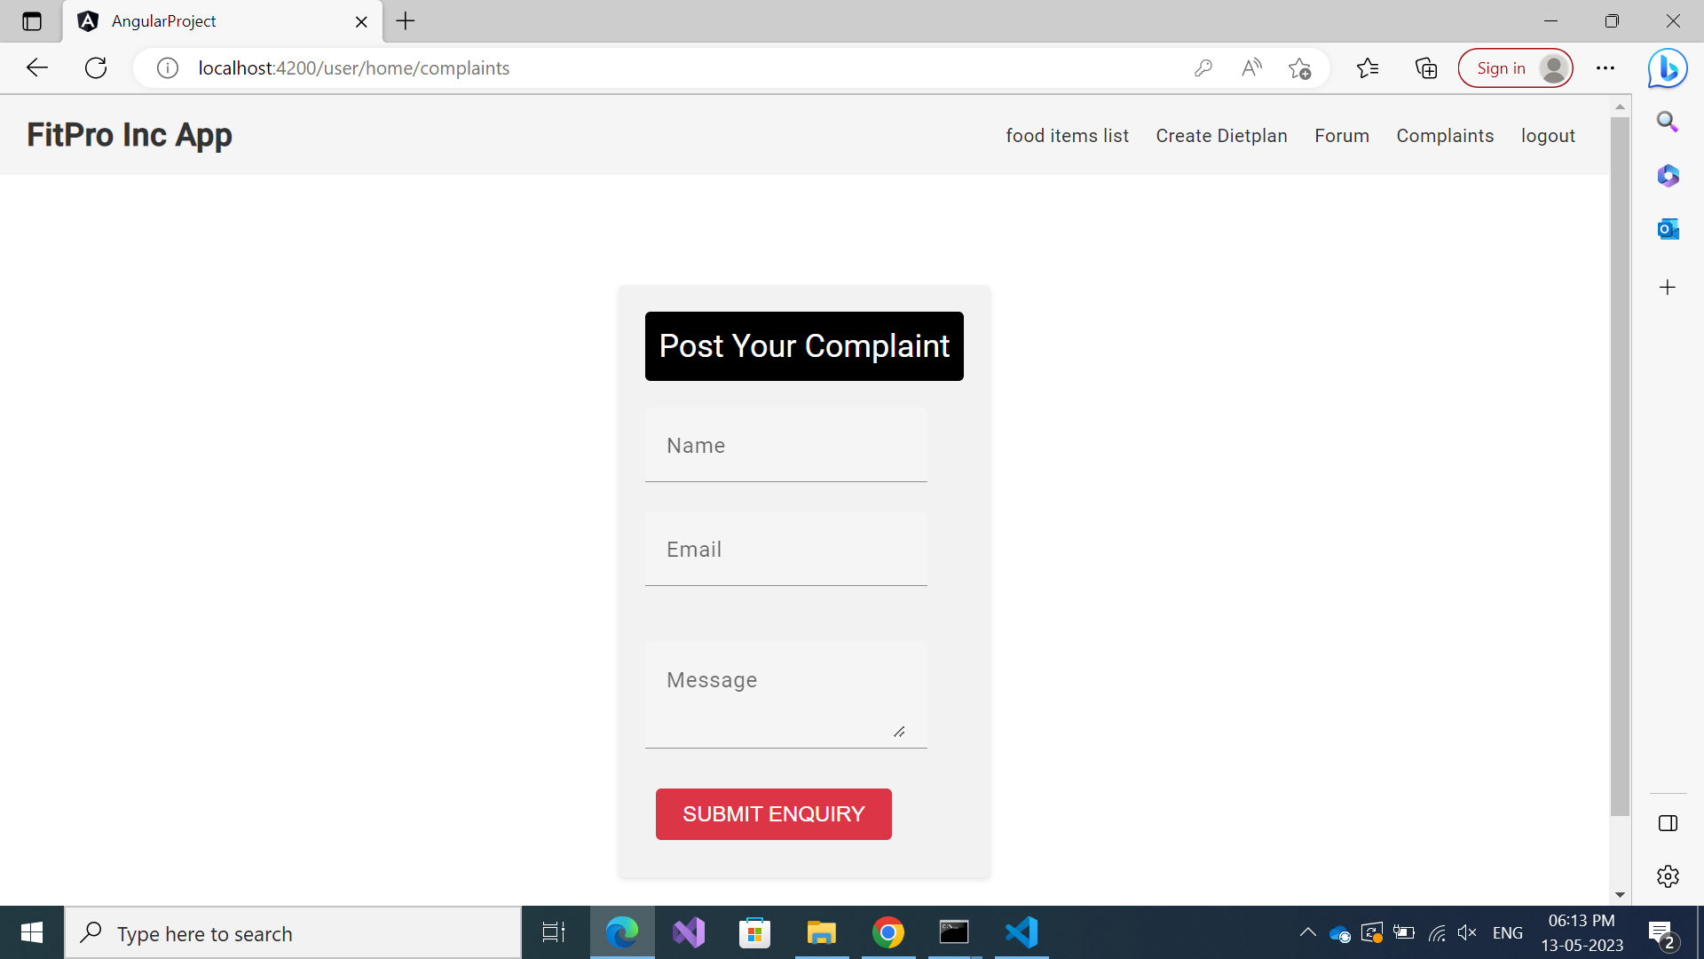
COMPLAINTS PAGE
The users can raise query
Or post a complaint
in this page and this
Will be displayed in admin
Side of page

Slide 7
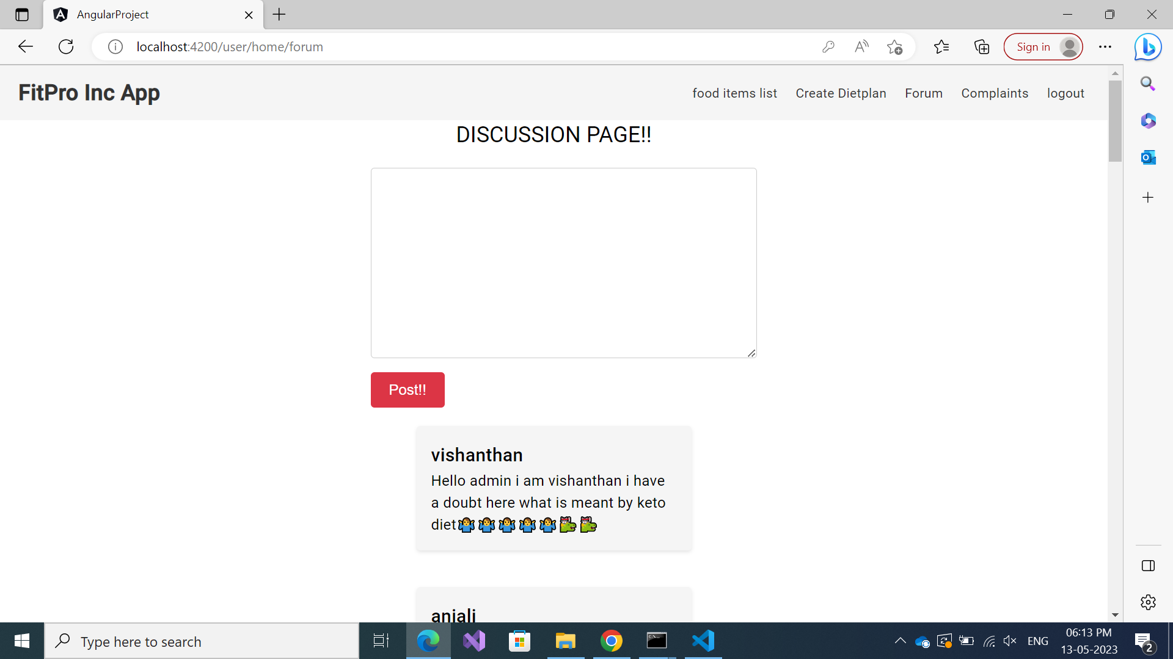
FORUM PAGE
The users can reply to
Each other in this page
And even admin can reply
To their comments .

Slide 8
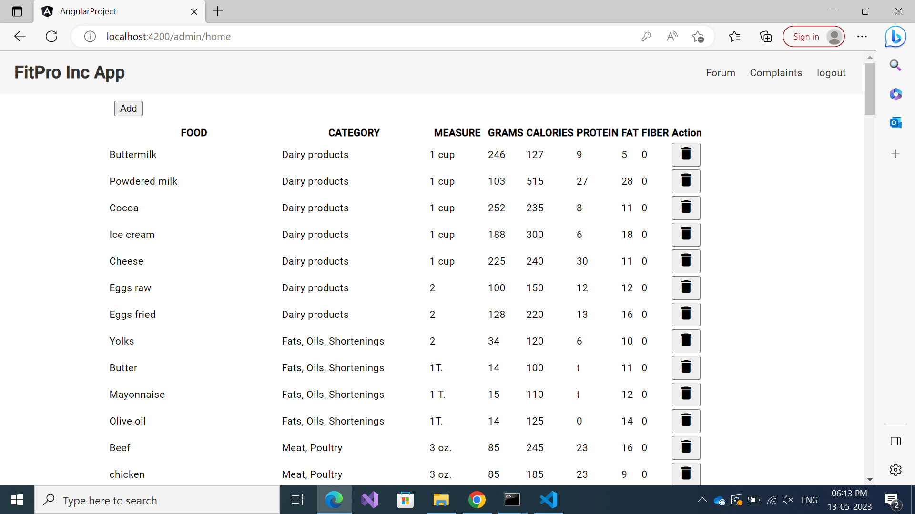
ADD/DELETE PRODUCT- ADMIN
Admin can add / update /
Delete the product in this
page .

Slide 9
THANK YOU

